Slide 1

STATISTICAL ANALYSIS OF WATER QUALITY USING PREDICTIVE MODELING AND MACHINE LEARNING TECHNIQUES

Slide 2
CONTRIBUTORS
Submitted By:
Samruddhi Rohokale Tejashri Tapare Rajesh Rasane
Zahra Merchant Zoha Bahlooli Monika Borude
Guided By:
Mr. Yogesh Yewale
Project Guide

Slide 3
AGENDA
Introduction
Statistical Analysis
Data Collection & Preprocessing
Exploratory Visualization
Machine Learning
Decision Tree
K-NN Classifier
Logistic Regression
Conclusion

Slide 4
MOTIVATION
Water plays the very crucial role in our life. Also, quality of drinkable water is very important. Main motive of this project is to classify whether the water is drinkable or not. So that we provide quality of water to the people
The polluted water affects environment greatly and leads to many waterborne diseases such as Cholera, Diarrhea, Typhoid, Hepatitis and various skin diseases. Motivation behind the project was to check the water quality.

Slide 5
INTRODUCTION
Water is one of the most fundamental necessities of life. Life would not be nearly possible without water.
We can’t decide water quality by our naked eyes. Different classifiers are used to check whether the given sample of water is drinkable or not
There are lot of classification model like Naïve bayes, Logistic regression, KNN, SVM, etc.
This project uses data provided from Kaggle.
The data which we used contains components which are in the water.
The sample of water is analyzed in the lab , for that we check the parameters like Ph, Hardness, Solids, Chloramines, Sulphate, Conductivity, Organic_Carbon, Trihalomethanes, Turbidity which have standard set of values.
Notes:
Tejashri

Slide 6
HYPOTHESIS TESTING
As our project aim is to check whether water is drinkable or not i.e., the given water is potable or not potable. So, for testing this claim we have to perform the hypothesis testing for each parameter
The first step to proceed by parameter testing we want to check whether the given sample is coming from normal population or not.
Shapiro-Wilk normality test (l .o . s = 5%)
To test: H0 = pH is normally distributed H1 = pH is not normally distributed.
Conclusion : As p-value for each test is less than 0.05 so we reject null hypothesis at 5% l .o . s we can easily conclude that the data does not follow normal distribution.
As data does not follow normal distribution. So, we should go with corresponding non parametric test.
Hypothesis is given as: H0: M = M0 VS H1: M ≠ M0
As all the null hypothesis is rejected for the given parameters, we can conclude that all the parameters are in suitable range.
But in future the decision may or may not be same as it is in the present because it depends on the given sample.

Slide 7
HEAT MAP
A heat map is basically the representation of two-dimensional information (data) with the help of colors.
The dark color represents the low correlation and the light color gives high correlation between the variable.
By using Python, we plot the heatmap for our data.
Conclusion of heat map : As the correlation coefficient are negligible, we can conclude that the parameters are uncorrelated.

Slide 8
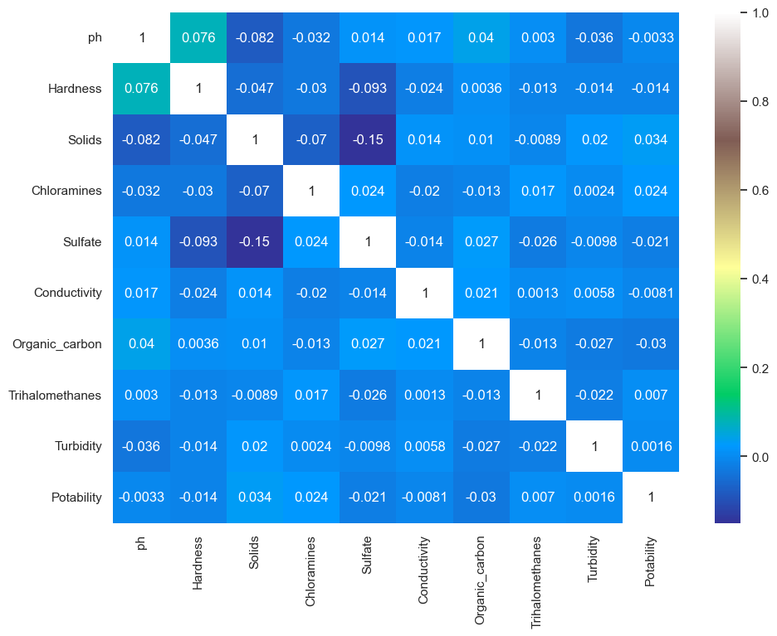
HEAT MAP

Slide 9
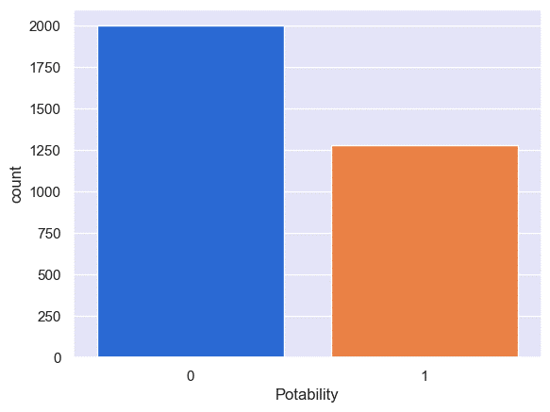
COUNT PLOT FOR POTABILITY
We just want to see the count of potability in data set.

Slide 10
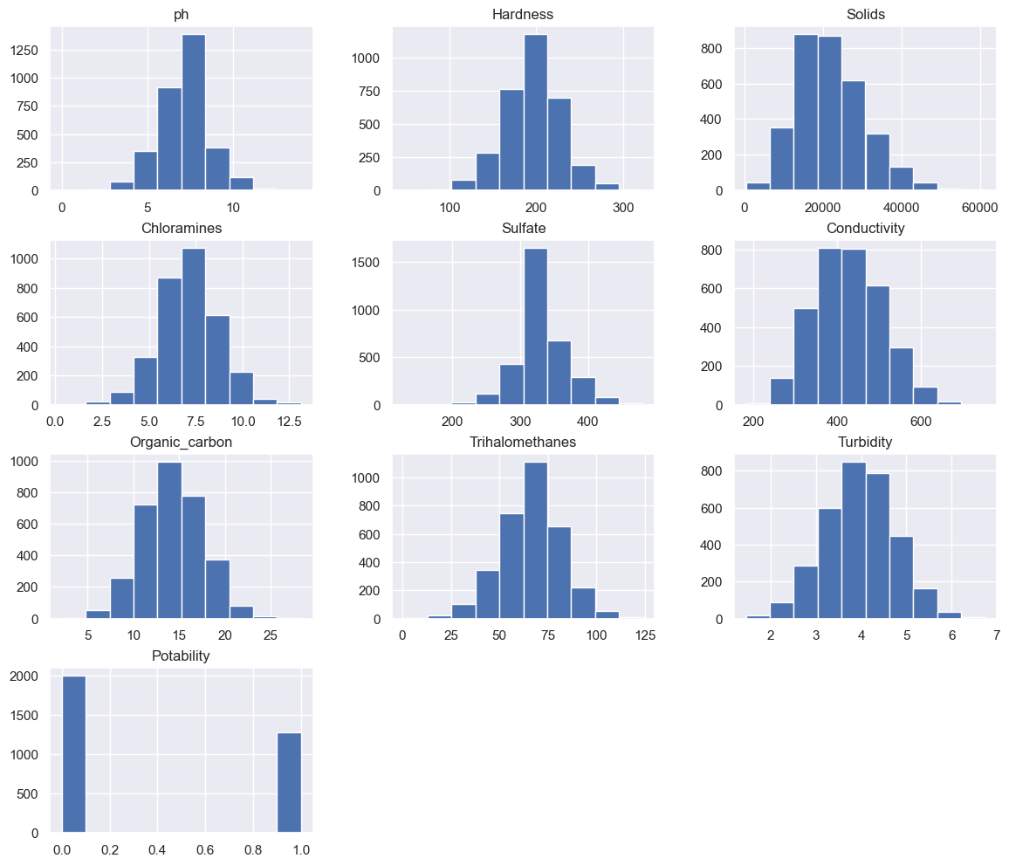
GRAPHICAL REPRESENTATION OF PARAMETERS USING HISTOGRAM
CONCLUSION: Data does not follow normal distribution.by Shapiro-wilk test also it was confirmed.

Slide 11
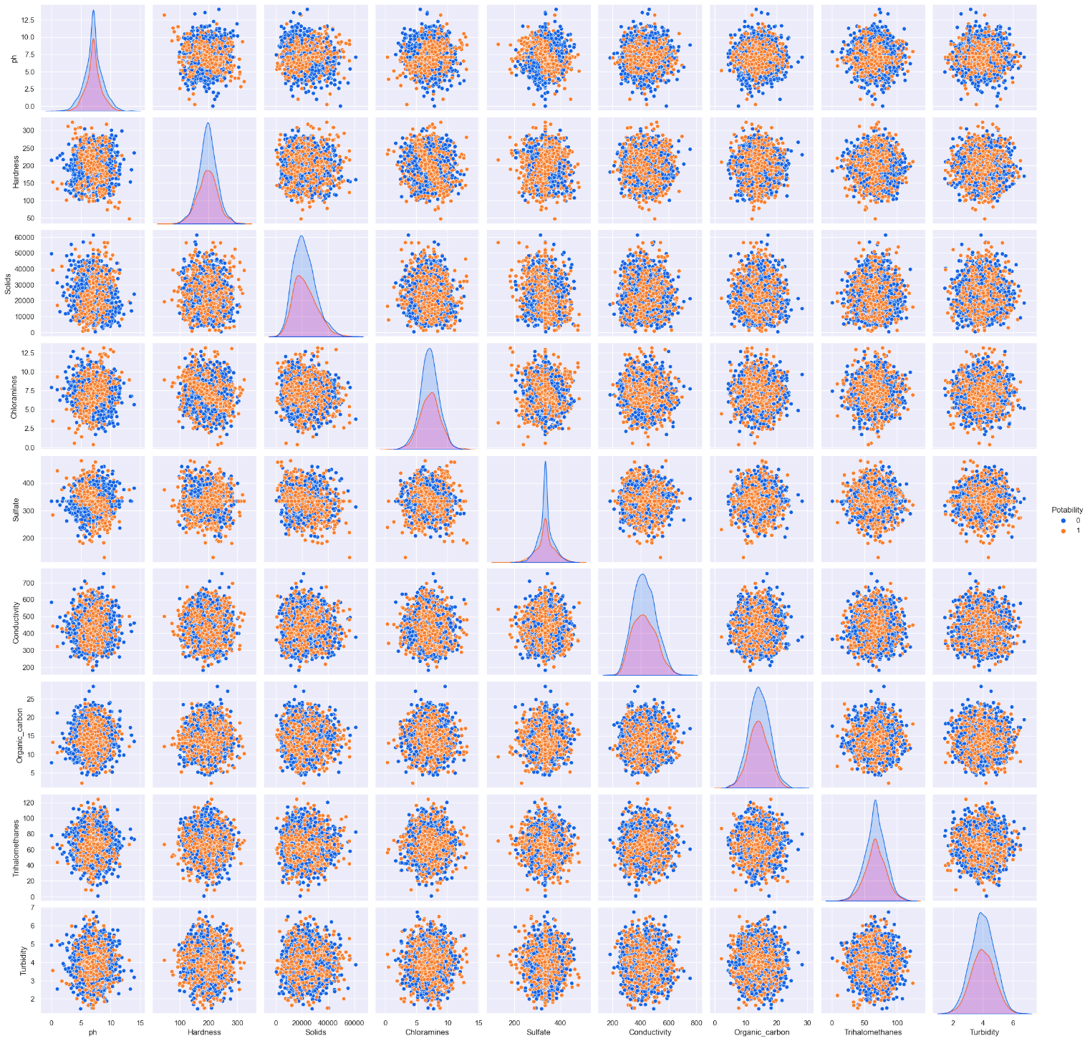
GRAPHICAL REPRESENTATION OF RELATIONSHIP BETWEEN THE PARAMETERS USING PAIRPLOTS:

Slide 12
MACHINE LEARNING
Machine Learning (ML) is basically the study of computer algorithms that can improve automatically through experience and by the use of past data.
This includes: • Outlier detection • Missing value imputation • Data sampling • Data scaling • Variable encoding
The response variable of our data was in the form of classification type. So, we classify our data in two groups namely potable water or non-potable water as like a binary variable. Potable water = 1 Non-Potable water = 0
There are several classification models that are used in machine learning. Out of that we used three methods : 1. Logistic Regression 2. K-Nearest Neighbors 3. Decision Tree.
To head start the ML process, the cleaning of data is must.
To reduce the errors and to increase the efficiency of model we need to clean our data. We will clean our data set using Python
Notes:
Zahra

Slide 13
DECISION TREE
Decision tree is a decision support tool that uses a tree-like model of decisions and their possible consequences, including chance event outcomes, resource. It is Supervised Machine learning algorithm which uses set of rules to make decisions. It is one of the classification algorithms which uses rule-based approach.
#Model fitting decision tree:
from sklearn.tree import DecisionTreeClassifier
from sklearn.metrics import accuracy_score,confusion_matrix,precision_score
data=DecisionTreeClassifier(criterion= 'gini', min_samples_split= 10, splitter= 'best')
data.fit(X_train,Y_train)
#Prediction for test dataset:
#Prediction for test dataset
prediction=data.predict(X_test)
prediction
Notes:
Rajesh

Slide 14
DECISION TREE : Evaluation
#Model Evaluation:
#Confusion Matrix array([[272, 132], [140, 112]], dtype=int64)
#Accuracy: accuracy_score: 58.536585365853654 %
#Conclusion: Accuracy rate for fitting model given by Decision tree is 58.53% of our data.
Advantage:
Simple to understand and to interpret
It can handle both numerical as well as categorical data.
Disadvantage:
Unstable: change sensitive
Relatively inaccurate
Bias in favor of attributes with more level
Calculations can get very complex

Slide 15
K-NEAREST NEIGHBOR
K-Nearest Neighbor is one is one of the simplest ML algorithms based on Supervised Learning Technique.
K-NN is a non-parametric algorithm
Both for classification and regression, a useful technique can be to assign weight to the neighbors
Among the various methods of supervised statistical pattern recognition, Nearest Neighbor rule achieves consistently high performance
#Model fitting and prediction for KNN
knn=KNeighborsClassifier(metric='euclidean',n_neighbors=22) knn.fit(X_train,Y_train)
#Prediction for test dataset:
prediction_knn=knn.predict(X_test)
Notes:
Monica

Slide 16
K-NEAREST NEIGHBOR: Evaluation
#Model Evaluation:
#Confusion matrix: confusion_matrix(prediction,Y_test) array([[272, 132], [140, 112]], dtype=int64)
#Accuracy accuracy_score: 60.97560975609756 %
#Conclusion: Accuracy rate for fitting model given by KNN is 60.97% of our data.
Advantages:
It is easy to implement
It is robust to noisy training data
It can be more effective if the training data is large
Disadvantages:
It is computationally intensive
Sensitive to outliers
Requires feature scaling

Slide 17
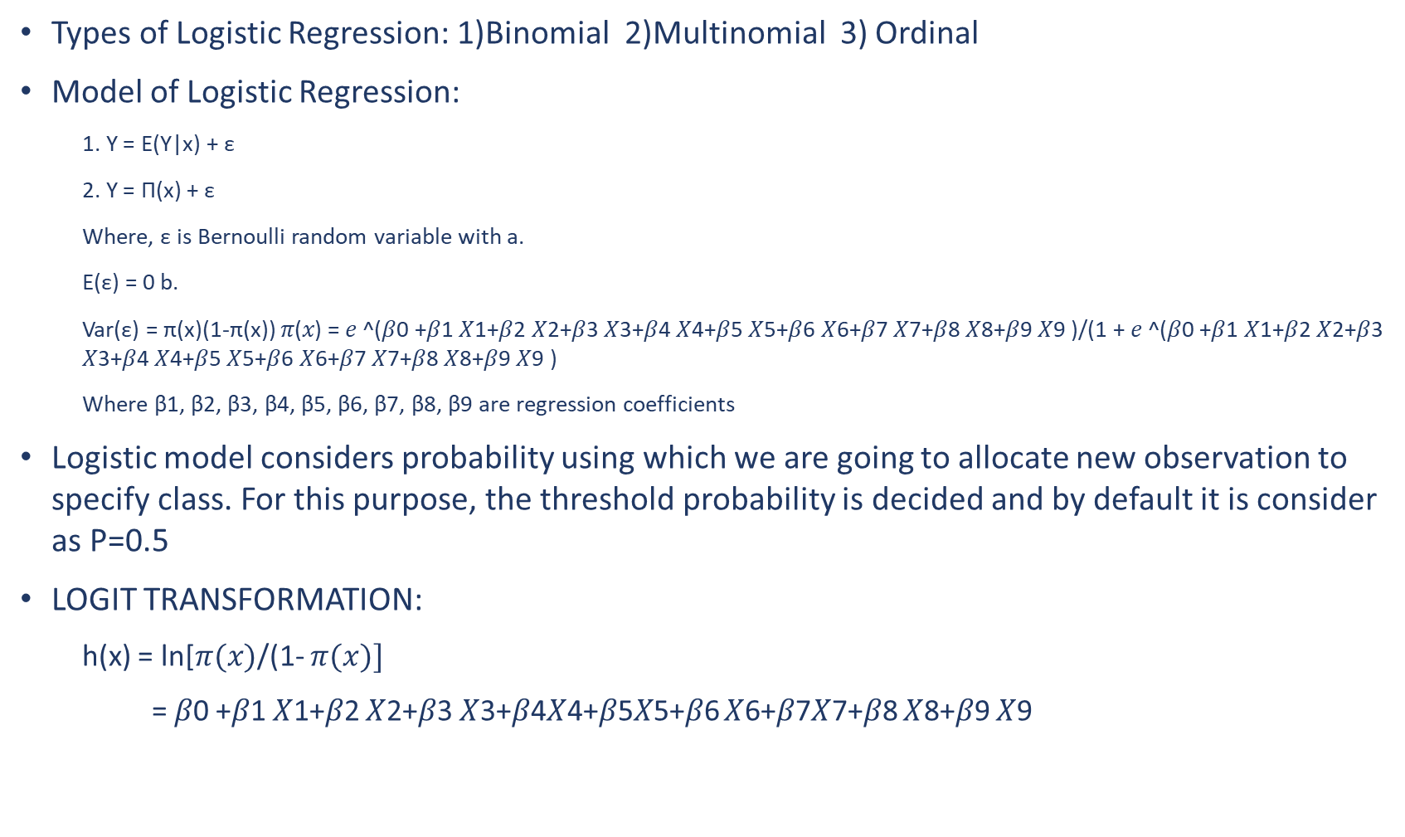
LOGISTIC REGRESSION
Types of Logistic Regression: 1)Binomial 2)Multinomial 3) Ordinal
Model of Logistic Regression:
1. Y = E(Y|x) + ε
2. Y = Π(x) + ε
Where, ε is Bernoulli random variable with a.
E(ε) = 0 b.
Var(ε) = π(x)(1-π(x)) 𝜋(𝑥) = 𝑒 ^(𝛽0 +𝛽1 𝑋1+𝛽2 𝑋2+𝛽3 𝑋3+𝛽4 𝑋4+𝛽5 𝑋5+𝛽6 𝑋6+𝛽7 𝑋7+𝛽8 𝑋8+𝛽9 𝑋9 )/(1 + 𝑒 ^(𝛽0 +𝛽1 𝑋1+𝛽2 𝑋2+𝛽3 𝑋3+𝛽4 𝑋4+𝛽5 𝑋5+𝛽6 𝑋6+𝛽7 𝑋7+𝛽8 𝑋8+𝛽9 𝑋9 )
Where β1, β2, β3, β4, β5, β6, β7, β8, β9 are regression coefficients
Logistic model considers probability using which we are going to allocate new observation to specify class. For this purpose, the threshold probability is decided and by default it is consider as P=0.5
LOGIT TRANSFORMATION:
h(x) = ln[$π(x)$/(1- $π(x)]$
= 𝛽0 +𝛽1 𝑋1+𝛽2 𝑋2+𝛽3 𝑋3+𝛽4𝑋4+𝛽5𝑋5+𝛽6 𝑋6+𝛽7𝑋7+𝛽8 𝑋8+𝛽9 𝑋9
Notes:
Samruddhi

Slide 18
LOGISTIC REGRESSION: Evaluation
#Model fitting and prediction for Logistic Regression Model:
#from sklearn.linear_model import LogisticRegression model = LogisticRegression() model.fit(X_train, Y_train)
#Prediction for test dataset: prediction=data.predict(X_test)
#Accuracy : The Accuracy for Test Set is 58.536585365853654 %
#Conclusion : Accuracy rate for fitting model given by logistic regression model is 58.53% of our data.

Slide 19
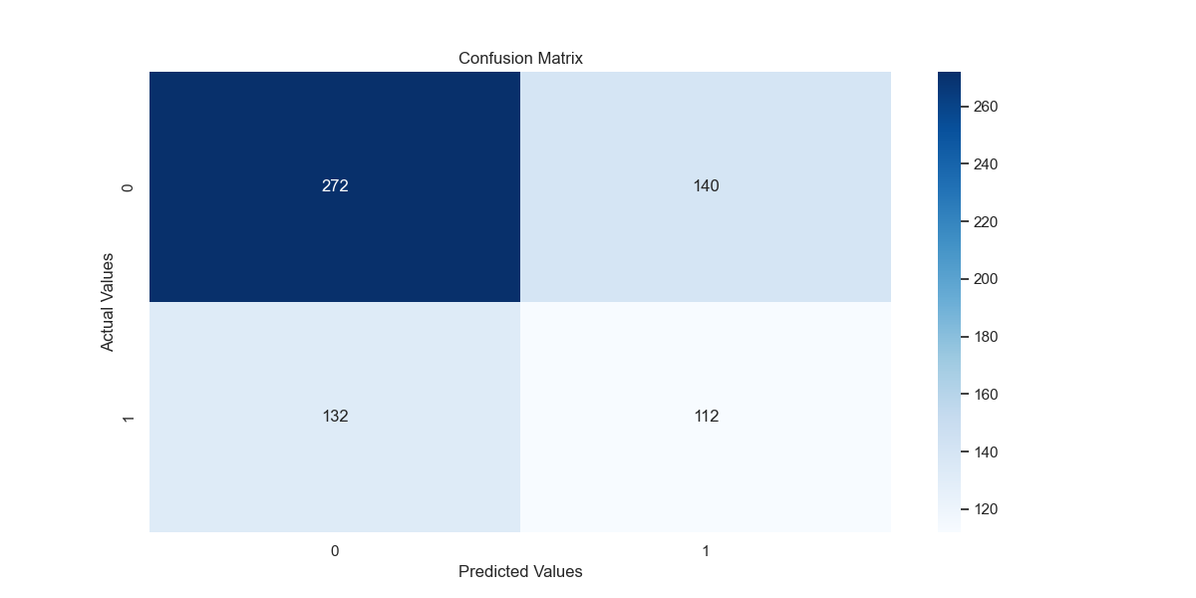
CONFUSION MATRIX

Slide 20
CONCLUSION
The classification models were used to analyze the water quality.
The supervised classification models namely decision tree, KNN model and Logistic Model were fitted to our sample data of 3276 sample points.
Of the three models that were fitted to this data, KNN model proved to be the best fit with accuracy 60.97%. With this accuracy, it concludes that our data is correct fitted.
Among all the three models’ logistic regression classifier has highest accuracy due to the very less miss classification. Hence, we can say that Logistics Regression model is best for our data.
Notes:
Tejashri

Slide 21
REFERENCES
BOOKS
1. Data Mining Concepts and Techniques (Third Edition) by Jiawei Han , Micheline Kamber, Jian Pei
2. Fundamentals of Python Programming by Richard L.Halterman
LINKS
1. https://www.kaggle.com/datasets/adityakadiwal/water-potability
2. https://www.analyticsvidhya.com/blog/2021/06/hypothesis-testingparametric-and-nonparametric-tests-in-statistics/
3. https://www.javatpoint.com/machine-learning
4. https://www.wikipedia.org/
5. https://github.com/python
6. https://www.analyticsvidhya.com/blog/2020/11/popular-classificationmodels-for-machinelearning/
7. https://www.kdnuggets.com/2020/01/decision-tree-algorithmexplained.htm

Slide 22
THANK YOU!

